Slide 1
CRYPTOCURRENCY
TOPIC MODELLING
Name: Kira Wong

Slide 2
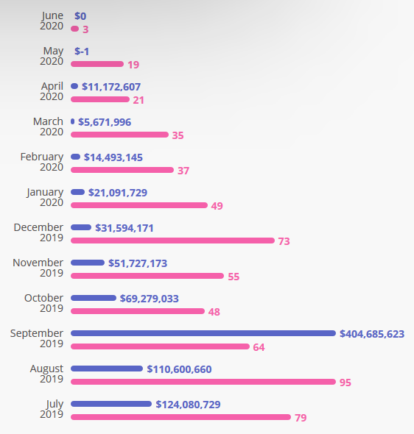
BACKGROUND
Cryptocurrencies are digital asset based on blockchain technology
Initial coin offering (ICO) are ongoing even in 2020
Taken from https://icobench.com/stats

Slide 3
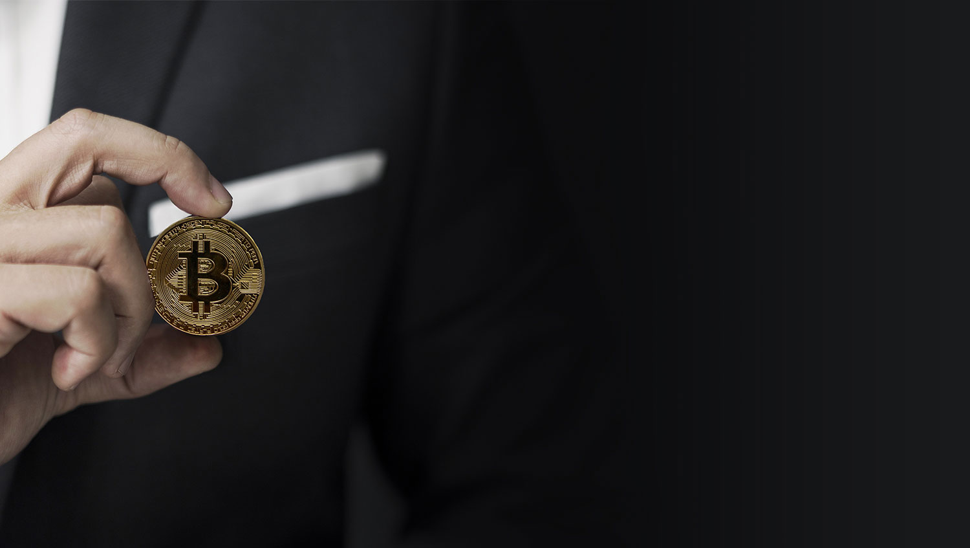
OBJECTIVE
Identify
What topics do people talk about when it comes to crypto currency?
Understand
Where to channel efforts to increase ICO success
Notes:
Opportunity lies in the challenge & complain

Slide 4


METHODOLOGY
Reddit
NLP
EDA
Web Scrape
Pre-processing &
Modelling

Slide 5
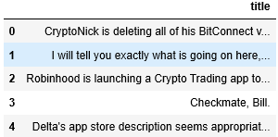
DATA SET
PRAW
01
Python package to communicate with Reddit’s API
02
Sub Reddit (r/CryptoCurrency)
Dedicated online community where people write on a particular topic
Scrape Post title
03
Titles contain relevant information

Slide 6
PRE-PROCESSING
1
Pandas
Numbers
Remove
2
Punctuation
Count vectorizer / TF-IDF
Remove
3
Letter-case
Count vectorizer / TF-IDF
Lower case
4
Stop words
Count vectorizer / TF-IDF
Remove common words such as “the”, “a”, “an”, “in”
5
Count vectorizer / TF-IDF
Anagram
Uni, Bi, Tri grams

Slide 7
NLP MODEL
Parameter :
NLP
Model
Pass
Number of topics
LSA
LDA
Anagrams
NMF
max_df
Notes:
Latent semantic analysis
Latent Dirichlet allocation
Search Results
Web results
Non-negative matrix factorization

Slide 8
COMPARISON
(Using count vectorizer)
LDA
Topic 0
0.011*"backed" + 0.009*"action video aug" + 0.008*"amazon petition" + 0.008*"banks world" + 0.008*"accepts crypto" + 0.008*"appropriate" + 0.008*"actual user company" + 0.008*"audit protocol" + 0.007*"amid crypto" + 0.007*"bank launch cryptocurrency“
Topic 1
0.011*"annual transaction" + 0.010*"account provided" + 0.009*"author rich" + 0.008*"banks announce immediate" + 0.008*"aths story" + 0.008*"alive" + 0.008*"advocate utoronto professor" + 0.007*"actually won" + 0.007*"alerts bitcoin broken" + 0.007*"banks credit“
Topic 2
0.010*"amex" + 0.010*"account just active" + 0.009*"annual" + 0.008*"avoid" + 0.008*"ans request beginning" + 0.008*"alerts bitcoin" + 0.008*"anonymity features wow" + 0.007*"ask ye" + 0.007*"afghanistan" + 0.007*"aware“)
Topic 3
0.010*"americans buying" + 0.009*"absurd journey reason" + 0.009*"authorities eos" + 0.009*"ask ye shall" + 0.008*"allegedly help" + 0.008*"absolutely unacceptable" + 0.008*"authority says" + 0.008*"annual transaction volume" + 0.007*"affair" + 0.007*"al erecting illegal"

Slide 9
COMPARISON
(Using count vectorizer)
NMF
Topic 0 fee, transaction, fraud, credit, department, fraud department, cash, card, pay, credit card
Topic 1 privacy, duckduckgo, search, data, great, information, brave, user, companies, shows
Topic 2 sherman, mining, rep, card, campaign, donor, brad, campaign donor, rep brad, rep brad sherman
Topic 3 total, billion total fines, penalties, billion total, fines, fines penalties, total fines penalties, total fines, fargo, wells fargo
LSA
Topic 0 credit, fee, card, transaction, credit card, fraud, department, fraud department, cash, pay
Topic 1 privacy, search, duckduckgo, data, great, information, brave, shows, trust, user
Topic 2 mining, metamask, allowing, app, total, store, congress, phone, doesn, google
Topic 3 total, total fines, fines penalties, total fines penalties, billion total fines, penalties, billion total, fines, wells, wells fargo

Slide 10
RESULTS
(using LSA)
4 Topics labelled :
Credit card Fraud
credit, fee, card, transaction, fraud, credit card, department, fraud department, cash, pay
Privacy invasion
privacy, duckduckgo, search, data, information, great, brave, user, shows, donations
Product Scams
total, fines, fines penalties, billion total, billion total fines, total fines, total fines penalties, penalties, wells, fargo
political barrier
mining, sherman, metamask, rep, congress, allowing, phone, campaign, senator, rep brad sherman
The present challenges to the adoption of crypto-currency by the public
Notes:
Use CC to buy bitcoin but deny buying
Blockchain reveals transaction
Wells fargo – scams own customer– fail to let customer knows of the risk of cryptocurrency
rep brad Sherman – crypto ban - Diminish American Power

Slide 11
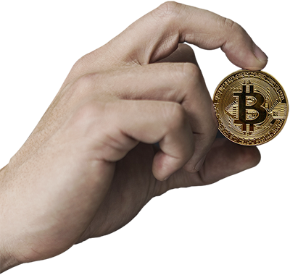
CONCLUSION
The present challenges to the mass adoption of crypto-currency by the public
Credit card Fraud
Privacy invasion
political barrier
Product Scams
Companies looking to ICO may stand a better chance of success if they can address these concerns
Notes:
Bitcoin transactions are irreversible, while credit card transactions are. So somebody can buy Bitcoin with a credit card, then call their bank and say they didn’t do it - the bank will reverse the credit card transaction, but the seller of the Bitcoin can’t take their BTC back.
This is why many exchanges are wary of accepting credit cards and PayPal and similar “non-permanent” forms of payment.
Bitcoin’s transaction ledger is completely open for the public to view.

Slide 12

INSIGHTS
Reddit recently offers 2 new Ethereum based crypto-currencies:
MOON
BRICK
Notes:
users earn cryptocurrency by contributing content and participating in discussions on the service.
-only fortnite game & Fortnite subreddit
spent on Reddit to acquire badges and other trinkets

Slide 13
FUTURE WORK
Explore different lemmatization options
Use topic distributions as part of input features for other models that predict bitcoin price
Data Visualization

Slide 14




`
Thank You
Any Questions?
Find me at:
Kirawong_datasci@hotmail.com
https://www.linkedin.com/in/kira-wong-69319318/
https://github.com/Kirawong_datasci

